Slide 1
Multiscreen Android Apps
CS235AM
Android App Development

Slide 2
Course Overview
Wk | Topic
1 | Intro + single-screen apps
2 | Multi-screen apps + activity state
3 | List Views
4 | Navigation with the ActionBar
5 | App Menus
Wk | Topic
6 | Adapting to size and orientation: Fragments
7 | Managing Data: SQLite
8 | Consuming Web Services
9 | Geolocation
10 | Publishing to the Google Play Store

Slide 3
Android App Architecture
Apps are made up of components. There are four kinds of components. One that every app must have:
Activity
Each screen is managed by it’s own activity
A multi-screen app will have multiple activities
Notes:
Services are long-running operations that run in the background
Content providers manage shared data. An app can query and modify another app’s data via a content provider. For example, the system has a provider for contact data
Broadcast providers respond to system-wide broadcast announcements. For example an announcement that the screen has turned off.

Slide 4
App Architecture (continued)
And three optional components:
Services: long-running background operations
Content providers: manage shared data
Broadcast receivers: respond to system-wide broadcast announcements
Intent objects are used to activate activities, services, and broadcast receivers
Every app must have a manifest file
Notes:
Services are long-running operations that run in the background
Content providers manage shared data. An app can query and modify another app’s data via a content provider. For example, the system has a provider for contact data
Broadcast providers respond to system-wide broadcast announcements. For example an announcement that the screen has turned off.

Slide 5
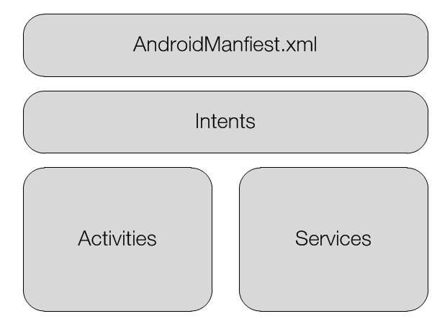
Components of an App
Notes:
An app must have a manifest and an activity, intents and services are optional

Slide 6
Activity class
Provides a user interface (UI)
Contains a window in which to add UI elements
Inherits from the abstract Context class
Each activity in a app is independent of the others
Can be activated from within it’s own app or by another app

Slide 7
Loosely Coupled Activities
Typical desktop apps have a single entry point. In an Android app, any activity (screen) can be an entry point.
Similar to web applications. You can typically directly open any web page in a site.

Slide 8
Context class
Provides a reference to the current application (sort of)
Provides a means to access the Android operating system
Used for:
Accessing Android services
Accessing preferences (settings) and permissions
Creating new views (controls)
Accessing device resources

Slide 9
Intent class
A class that contains a message
It specifies an action for the OS or an activity to perform
Most often used to launch new activities
It carries data

Slide 10
AndroidManifest.xml
Required for every application
Registers information about the app:
Components that make up the application (including Activities and Intents)
Required permissions
Minimum OS version supported

Slide 11
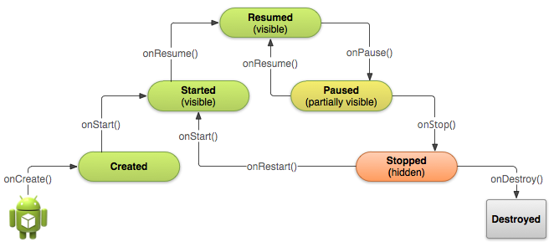
Activity Lifecycle
From http://developer.android.com/training/basics/activity-lifecycle/
Notes:
We will cover this in more detail next week

Slide 12
Tutorial
Do the Hello, Multiscreen Applications tutorial together.

